Slide 1

Python Fundamentals
Course Introduction
SoftUni Team
Technical Trainers
Software University
https://softuni.bg/

Slide 2
Table of Contents
Course Objectives
Training and Team
Course Organization
Course Infrastructure
Evaluation Criteria
2

Slide 3
Have a Question?
sli.do
#fund-python

Slide 4













SoftUni Diamond Partners

Slide 5

Course Objectives

Slide 6
Python Fundamentals Objectives
Working with linear data structures
Lists
Defining functions and simple classes
Working with objects
Processing and manipulating strings
Regular expressions
6

Slide 7
Practical Programming Exam
Mid Exam – 4 hours
3 practical problems
Conditional Statements and Loops
Linear Data Structures – Lists
Final Exam – 4 hours
3 practical problems
Dictionaries
Strings and Text Processing
Regular Expressions
7

Slide 8
Theoretical Exam
You will have 30 minutes once you enter
Multiple-choice with 1 correct answer
Test will be in English
Automated quiz system
Available online on the day of the practical exam
You can submit your answers just one time
8

Slide 9

The Team

Slide 10
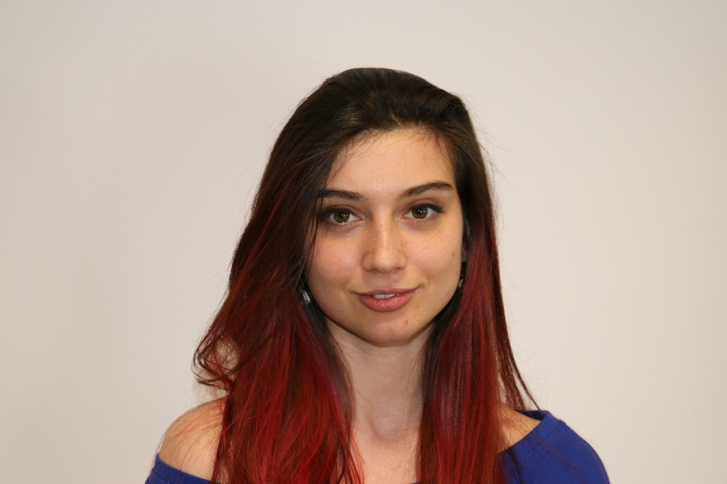
Ines Ivanova
Python web developer at IQVIA
Full stack freelance developer
Python, Django, C#, Angular, HTML,
CSS, jQuery, Flask

Slide 11

Course Organization

Slide 12
Python Fundamentals Module
11-Jan-2021
27-Feb-2021
03-Apr-2021
06-Apr-2021
09-Apr-2021
Python Fundamentals
12 weeks * 3 times / week
12 credits
Start: 11-Jan-2021
Mid Exam: 27-Feb-2021
Theoretical Exam: 03-Apr-2021
Final exam: 03-Apr-2021
Re-Take Exams
Mid Exam Retake: 06-Apr-2021
Theoretical Exam Retake: 09-Apr-2021
Final Exam Retake: 09-Apr-2021

Slide 13

Homework Assignments & Exercises
Your homework is mainly work in class
Lesson days → slides + live demos + exercises
Exercise days → only exercises
How to submit your homework?
Submitted in the judge system
Do your homework when it's due
Assignments pile up quickly

Slide 14


SoftUni Certificate
Practical Exam 100%
Homework 5%
Evaluation
14

Slide 15
CPE Certificate
Theoretical Exam 100%
Evaluation
15

Slide 16


Course Web Site, Forum and FB Group
Official web site:
Softuni Python Community group:
https://softuni.bg/courses/programming-fundamentals-csharp-java-js-python
https://www.facebook.com/groups/SoftUniPythonCommunity

Slide 17
Questions?
Notes:
17

Slide 18
Trainings @ Software University (SoftUni)
Software University – High-Quality Education, Profession and Job for Software Developers
softuni.bg, softuni.org
Software University Foundation
softuni.foundation
Software University @ Facebook
facebook.com/SoftwareUniversity
Software University Forums
forum.softuni.bg
18
Notes:
18

Slide 19

License
This course (slides, examples, demos, exercises, homework, documents, videos and other assets) is copyrighted content
Unauthorized copy, reproduction or use is illegal
© SoftUni – https://softuni.org
© Software University – https://softuni.bg
Notes:
19

